Slide 1
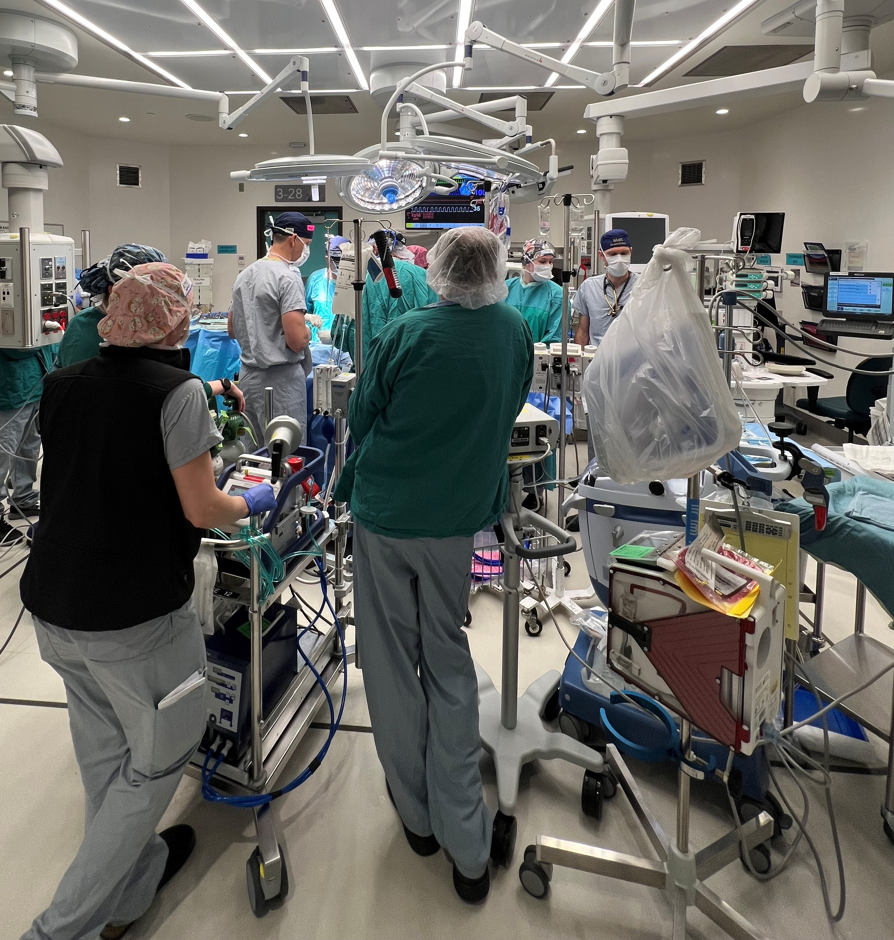
ECMO in the OR
September 27, 2023
Alyssa Schrenk CPC, CCP
Clinical Perfusionist
Cara Summers CPC, CCP
ECLS Coordinator
Clinical Perfusionist

Slide 2
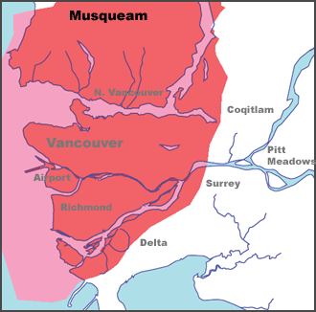
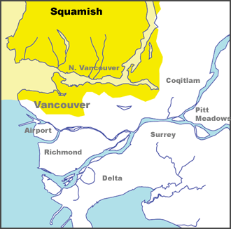
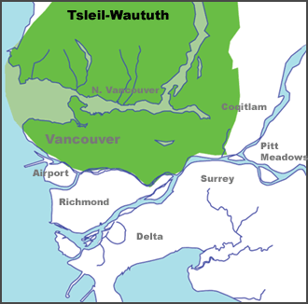
Land Acknowledgement
We would like to acknowledge that we are gathered today on the traditional territories of the Musqueam, Squamish and Tsleil-Waututh peoples.
Source: www.johomaps.net

Slide 3
Content
ECMO circuit
VV ECMO
VA ECMO
Preparing for ECMO in the OR
Typical goals
VGH ECMO stats

Slide 4
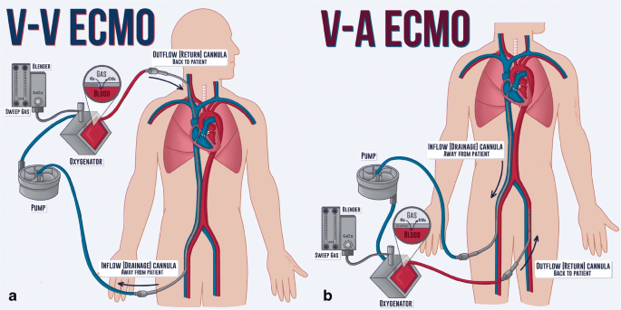
What is ECMO?
Extracorporeal Membrane Oxygenation
Takes over the function of the lungs or the heart and lungs

Slide 5
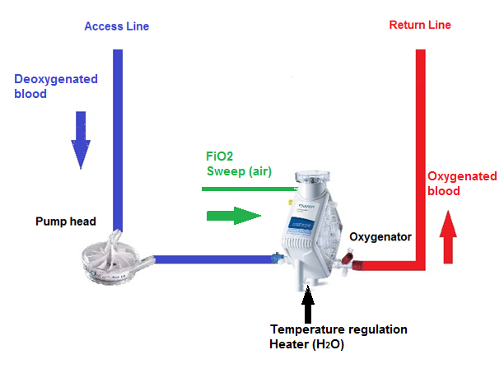
Basic Components of an ECMO circuit
Access cannula(s)
Heparin-coated tubing
Blood pump
Heat exchanger
Membrane oxygenator
Return cannula(s)
Prime ~ 600 mL Plasmalyte
Console/monitors
Notes:
Deoxygenated blood is drawn through heparin coated tubing by a centrifugal pump, and then propelled out at the positive pressure outlet to the oxygenator.
By setting RPMs (the speed at which the centrifugal pump spins), a measured flow rate is seen
These pumps are preload dependent and afterload sensitive, so changes in volume status and BP can dramatically affect how much flow (output) the circuit is providing to the patient
The oxygenator provides a means of gas exchange where sweep is set in L/min and acts as CO2 clearance and FiO2 is set for oxygenation
A built in heat exchanger is incorporated in the oxygenator for temperature regulation when connected to the heater unit
Oxygen rich blood leaves the oxygenator and is returned to the patient via the return line and cannula, the modality of ECMO determines what vessel this blood is returned into (arterial vs venous)
Plasmalyte is used to prime the circuit to ensure an air free connection
We have the ability to monitor and control other variables on the circuit console such as access pressure (Cardiohelp), pre and post oxygenator pressures, and the ΔP or change in pressure across the oxygenator, temperature, alarms such as bubble detection, etc.

Slide 6
VenoVenous (VV) ECMO
Bridge to LTx
Post LTx
ARDS
Aspiration/airway obstruction
Trauma
Liver Tx
Status asthmaticus
Takes over the function of the lungs for lung rest and recovery
Removes blood from the venous system
Oxygenates and removes CO₂
Returns oxygenated blood back to the venous system
Ventilator set to “rest settings”
Cannulation options: single lumen or dual-lumen
Notes:
Blood is drained from and returned to the venous circulation
Does not provide hemodynamic support
VV ECMO captures about 75% of the native cardiac output
Goal is to rest the lungs and allow time for healing

Slide 7
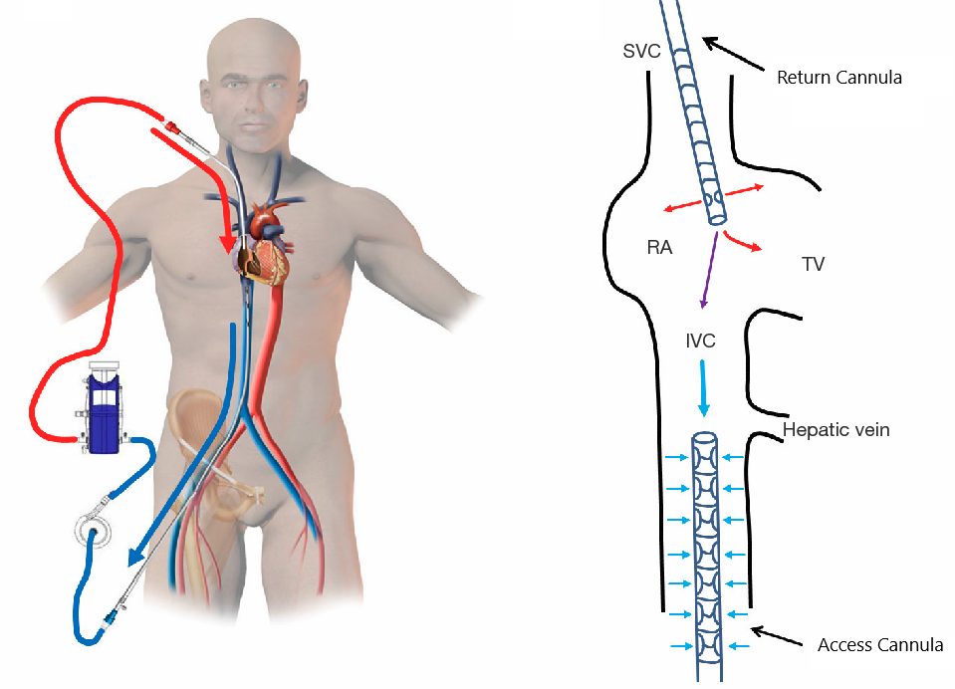
VV ECMO – Single-Lumen Cannulation
Cannula in the femoral vein drains deoxygenated blood into the ECMO circuit
Cannula in the right internal jugular vein returns oxygenated blood to the RA
Notes:
Cannula configuration is FV access/RIJ return

Slide 8
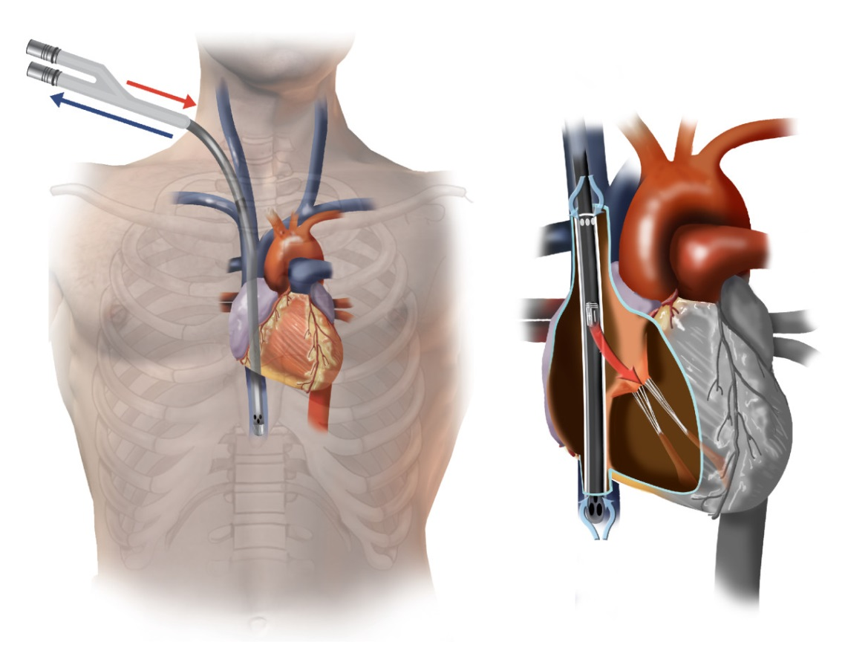
VV ECMO – Dual-Lumen Cannulation
Dual lumen cannula (MC3 Crescent)
Cannula in the RIJ
One lumen drains deoxygenated blood from the SVC + IVC
The other lumen returns oxygenated blood into the RA, directing blood flow through the TV
Fluoroscopy-guided insertion
Notes:
RIJ insertion
One lumen drains deoxygenated blood from SVC + IVC
Other lumen returns deoxygenated blood into the RA

Slide 9
VenoArterial (VA) ECMO
Trauma
Post-cardiotomy patients (failure to wean from CPB)
Post cardiac arrest or cath lab procedure
Shock (cardiogenic, septic)
During cardiac arrest (Extracorporeal Cardiopulmonary Resuscitation (ECPR))
Hypothermic rewarming
Takes over the function of the heart and lungs
Removes blood from the venous system
Oxygenates and removes CO₂
Returns oxygenated blood back to the arterial system
Ventilator settings adjusted to oxygenate native blood flow through the heart
Cannulation options: central or peripheral
Notes:
Takes over the function of the heart and lungs
Goal is to capture as much blood flow as necessary to support the heart but also maintain patient pulse pressure of at least 10
ECPR: witnessed in-house arrest with immediate CPR and on ECMO within 60 min

Slide 10
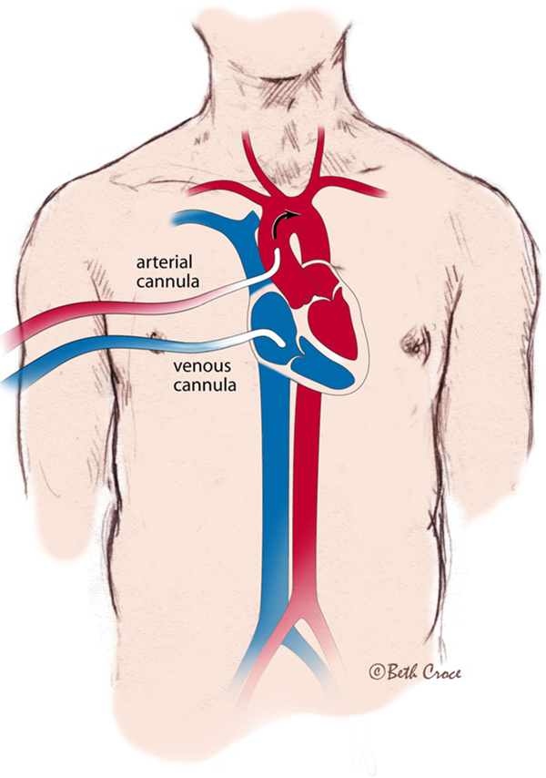
VA ECMO – Central Cannulation
Open chest patient, typically post cardiotomy
Cannula in the right atrium drains deoxygenated blood into the ECMO circuit
Cannula in the aorta returns oxygenated blood to the body
Notes:
Post cardiotomy patients unable to come off CPB may be converted to ECMO using the same central cannulas from the CPB run
Lung transplant patients requiring VA ECMO may also be cannulated centrally
This is generally to support the patient for implant of the second lung if PA pressures become too high (>80 or >2/3 systolic) and management with iNO & vasodilators are not enough
These patients may convert to CPB if PAH, pulmonary fibrosis, high PA pressures or if surgical visualization is an issue and the heart needs to be decompressed by allowing the blood to drain into the CPB reservoir

Slide 11
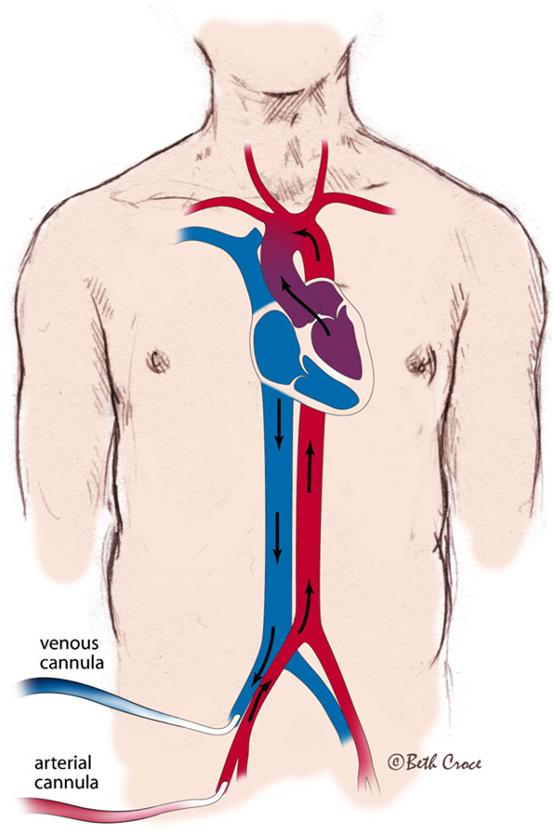
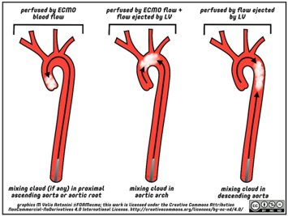
VA ECMO – Peripheral Cannulation
Cannula in the femoral vein drains deoxygenated blood into the ECMO circuit
Cannula in the femoral artery returns oxygenated blood to the body retrograde up the aorta
Technique is direct cut down or percutaneous
+/- Distal limb perfusion cannula
Notes:
Peripheral cannulation of the femoral artery sends ECMO blood in the retrograde direction to native blood flow
This can increase LV afterload and thereby O2 demand
Blood that is ejected from the LV antegrade into the aorta admixes with the flow from the ECMO (mixing cloud)
There is risk of lower limb ischemia in smaller sized patients if the femoral cannula occludes the femoral artery
This occlusion can drastically reduce distal perfusion to the legs
To avoid ischemic damage and possible future amputation, an 8F distal limb perfusion cannula is inserted in the opposite direction to send blood flow to the lower leg

Slide 12
Preparing for ECMO in the OR
Pre-procedure
Cannulation
Complications
Considerations
Weaning and Decannulation
Notes:
ECMO can be very complex, there are many considerations to keep in mind while managing these patients

Slide 13
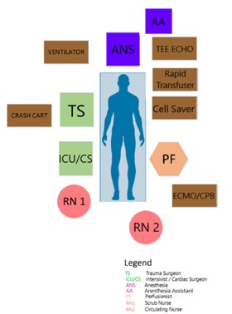
Preparing for ECMO in the OR: Pre-procedure
Room set up
Monitoring:
Right radial or brachial arterial line
Right hand SpO₂ monitoring
CVC
+/- NIRS
PRBC available in the blood fridge
Notes:
Considerations for the layout of the room include additional equipment and personnel; this figure shows a standardized set up for trauma ECMO initiation
Concern of differential hypoxia for peripherally cannulated VA patients (does not occur with central cannulation)
Changes in CO and ECMO flow will change where the blood mixes in the aorta
There is risk of poor cerebral/upper extremity perfusion depending on meeting of retrograde ECMO flow with native antegrade flow
The R radial arterial line, flowing from the right brachiocephalic, is from the proximal aorta and accurately reflects cerebral perfusion
Ensure a group and screen is completed and XM blood is in the fridge before the procedure starts

Slide 14
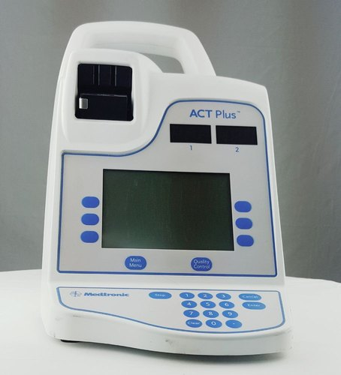
Preparing for ECMO in the OR: Cannulation
Unfractionated heparin bolus at time of cannulation
ABG/ACT drawn from patient arterial line q30min
Maintenance heparin infusion/subsequent heparin boluses to target ACT 180-220s
Notes:
50 units/kg bolus – generally about 3-5Ku at cannulation
During cannulation, there can be static blood in the cannulas → this creates risk of clotting if inadequately heparinized
ACTs will be checked q30min, redosing 1-2k as necessary to target 180-220s
Management of systemic anticoagulation immediately before and during surgery should be decided on a case-by-case basis by the surgery, anesthesiology, and intensive care unit (ICU) teams, and should be influenced by the type of ECMO (VA versus VV), the cannulation scheme (central versus peripheral), the patient’s perceived thrombotic risk, and the anticipated risk of bleeding during the surgical procedure

Slide 15
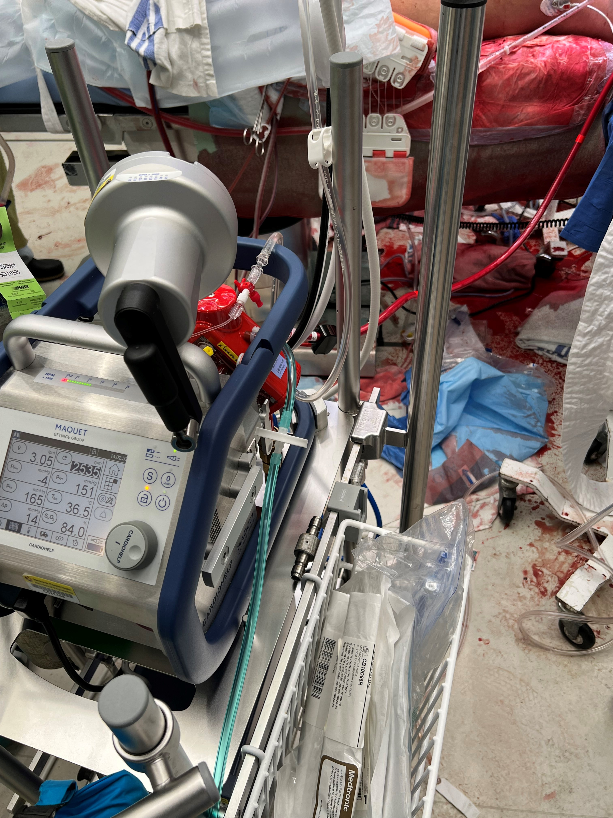
Preparing for ECMO in the OR: Complications
Vascular injury
Bleeding
Chatter
Recirculation (VV ECMO only)
Clot
Concentrated coagulation factor administration
Low flows
Pump failure
Cannula dislodgement
Gross air
Limb ischemia
Notes:
Vascular Injury
This may happen at the time of cannulation or mid case if there is a lot of manipulation with the aortic cannula
TEE guidance will be used when cannulating and we will flush the circuit to the patient before initiating ECMO
Having the cannulas well secured after cannulation will reduce the chances that surgical manipulation of the lines doesn’t cause dissection
Be cautious accessing the ETT or things under the drapes, as this manipulation may also contribute to potential dissection
Conversion to CPB if dissection is noted as vascular repair is needed
If chatter is seen the suction pressure at the access cannula exceeds venous return
Inflow is interrupted due to partial or complete occlusion of the venous cannula inlet ports by the collapsible venous walls
After a few seconds, ongoing venous return creates enough pressure to open the vein fully and the cannula ports reopen to function once more
This cycle repeats itself resulting in unstable, fluctuating ECMO flows (shown in L/min on the ECMO console) despite a stable pump speed (RPMs)
In addition to inadequate perfusion, there is risk of circuit clots during periods of reduced flow
Perfusion will first attempt to mitigate by decreasing RPMs on the pump, and thus reduce the negative pressure
It’s a temporary fix, and if chatter persists we may ask anesthesia to give volume
Your role when we ask this is knowing what form of volume replacement to give: PRBC, albumin, Plasmalyte, etc.
The common causes of chatter we see are hypovolemia/ hemorrhage, poorly situated access cannula (too low), excessive pump speed (RPMs), patient coughing/straining, or patient position (i.e. an obese patient on their side)
Recirculation
Occurs with VV ECMO patients only and is suggested by high SvO2 (>80%) occurring when the cannulas are situated too close together or when the pump flow exceeds the cardiac output
Flow from the return cannula enters the access cannula, rather than being distributed to the patient
We can reduce the RPM to see if that helps reduce the amount of blood drawn back into the ECMO circuit for a temporary fix, however if the patient is requiring more flow to adequately support their disease process, we may ask you to check cannula positions on the TEE, specifically the position of tips or to assess for any dynamic changes in their cardiac output
In the instances of circuit clot or pump failure – we will be trouble shooting the ECMO whether that be preparing for a circuit change or hand cranking
In this time, especially if we are “off” ECMO, Anesthesia is needed to fully support the patient with full ventilation, pressors/inotropes, volume etc.
The anesthesiologist should be prepared to support the patient’s hemodynamics and respiratory function if a pump failure occurs
Cannula dislodgement
We do our best to observe that the cannulas are well secured once placed, accidental cannula dislodgement can still happen
Perfusion should be made aware if the patient or the bed needs to be repositioned so we can watch the lines
If the cannula does come dislodged, we will clamp the ECMO lines to avoid air entrainment or exsanguination and full support by anesthesia is needed as we will be “off” ECMO until the cannulas are replaced and we can re-initiate support
Cannot handle air
If a new central line is being inserted, let us know so we can turn down the flow on the circuit temporarily
Be mindful accessing venous central lines – open central line ports may entrain gross air into the ECMO circuit due to the high negative pressure draw
Limb ischemia
As mentioned, femorally cannulated VA ECMO may cause poor/occlude distal limb perfusion
Monitor lower limbs for dusky coloration, poor capillary refill, loss of pulses

Slide 16
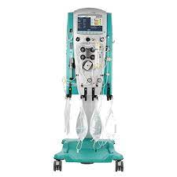
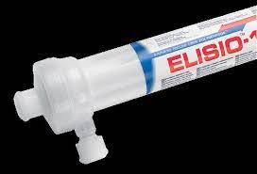
Preparing for ECMO in the OR: Considerations
Dialysis
We do not do this on ECMO, please don’t ask ☺
ECMO does not decompress the heart
Closed system with no reservoir to drain the patient
External decompression options:
Ballon atrial septostomy
Direct LV vent
IABP
Impella (currently not available)
Drug administration
Notes:
Attaching the dialysis machine, or anything, to the ECMO circuit, creates excessive risk
High negative pressure means air entrapment is always a risk, and it will stop flow on the circuit immediately
ECMO access ports will always be under high pressure as they are all post pump/pre/post oxy
Because the ECMO circuit has no reservoir unlike bypass, we are unable to decompress the heart
Contributors to left ventricular distention include inadequate venous drainage, reduced myocardial contractility, increased ventricular afterload, and aortic insufficiency
Sequestration of some drugs into the circuit/ oxygenator
The volume of distribution is increased for most lipophilic anesthetic drugs, as the ECMO circuit adds approximately 800 to 1500 mL to the patient’s blood volume
Highly lipid-soluble and protein-bound drugs (most sedatives) have the most sequestration in the ECMO circuit and often require higher doses in ECMO patients – think Propofol, opioids, benzos
The principal mechanism accounting for drug sequestration is adsorption onto artificial surfaces in the ECMO circuit, and sequestration is proportional to circuit surface area

Slide 17
Preparing for ECMO in the OR: Weaning and Decannulation
VV
Full ventilation trial (done in ICU)
Sweep off trial
Maintain current ECMO blood flow
Turn OFF ECMO sweep/FiO₂
Fully ventilate
End tidal during VV weaning trial
Decannulation at bedside
VA
Weaning trial via wean of ECMO flow
Fully ventilate
Optimize inotropes and vasopressors
Echo/TEE guidance
Decannulation in OR (vascular repair)
Circuit cell saving (intra-op patients)
Notes:
VV wean: percutaneous cannulation of the venous system does not generally require vascular repair
Majority of the time VV wean and decannulation is done in the ICU
The main point to take in for weaning VV patients is that we wean by decreasing/turning off the gas source and just allowing the blood to circulate through the ECMO as a shunt, not contributing to gas exchange
We are able to assess the patients native lung function with the support of the ventilator by drawing repeat ABGs
The patient may be maintained overnight with sweep off and reassessed at rounds the following day for decannulation
FVT – RT adjusts/ optimizes oxygenation and ventilation while ECLS flow/ sweep/ FiO2 are maintained
Vt < 6ml/kg
Optimal peep
Increase driving pressure on ventilator while maintaining Pplat <30
FiO2 set to 30% or lowest possible to achieve SpO2 goal, ABG drawn after 5min as a baseline
FiO2 increased to 100%
FVT ABG should demonstrate a significant increased in PaO2 when adjusted from baseline to 100% and indicating their readiness to trial off
VA wean: because vascular repair is needed, VA decannulation is done in the OR
Confirm etiology of cardiac failure is compatible with myocardial recovery, low doses of inotropes/vasopressors with adequate MAP (> 60 mmHg), major metabolic disturbances have resolved
Consider indication for transition to VV ECMO support (P:F ratio < 100)
Heparin bolus to facilitate low flow state/potential clamping of circuit
Policy is to assess heart function at no lower than 1L/min ECLS flow
Patient is monitored for rises in filling pressures, elevated lactate, hypoxemia, decreased SvO2, LV/RV dysfxn on echo
VA hemodynamic values to consider for decannulation:
CI >2.4L/min/m^2
MAP >60mmHg
LVEF >20-25%
Aortic VTI >10cm
Mitral TDSa >6cm/s
If wean trial successful, the patient will be decannulated with vascular repair before closing
If the circuit is initiated intraoperatively, our practice is to cell save and return it to the patient
For the long term ICU patients, we typically do not cell save the circuit due to risk of clot formation

Slide 18
Notes:
Here is a copy of our weaning policy, we are happy to share this with you

Slide 19
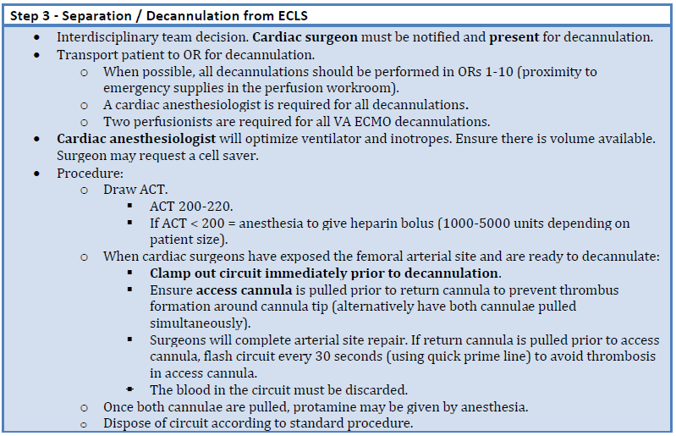

Slide 20
Typical Goals
Hemoglobin ≥ 80...
Platelets > 50
INR ≤ 1.8
Fibrinogen ≥ 1.0
Temperature: normothermic*
Net fluid balance
*unless post-arrest, hypothermic, etc.
Notes:
Post arrest we may keep the patient slightly cooler

Slide 21
VGH ECMO Intra-op 2016-Present
Procedure | Total # ECMO Runs | Type | % Survival to D/C
Liver Tx | 4 | 2 VV 2 VA | 100% VV 0% VA
Trauma | 19 | 13 VV 6 VA | 54% VV 33% VA
Thoracic (tracheal stenosis + tracheal rupture) | 2 | VV | 100%
Hypothermic rewarm | 3 | VA | 33%
Septic shock | 2 | VA | 50%
Vascular (intravascular tumor) | 2 | VV | 100%
Notes:
Excluding cardiac surgery and lung transplantation

Slide 22
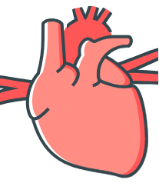
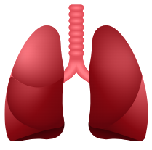
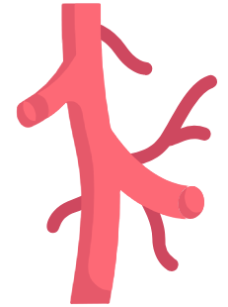
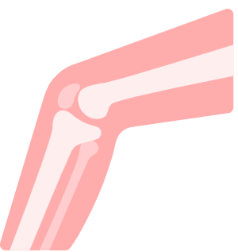
Intra-Op Procedures While on ECMO
Cardiac
Valve replacement, CABG
Thoracics
Thoracotomy, chest exploration
Wedge resection
Vascular
Fasciotomy
Leg amputation
Ortho
Ex fix
Gen surg
Laparotomy
Bowel resection
Notes:
Even if the patient is not cannulated intra-operatively for surgical support, many of our ICU patients require surgery while on ECMO
Variety of specialties, procedural considerations, always a team management approach

Slide 23
VGH ECMO Stats 2023 To Date
ECMO | Total # ECMO Runs | % Weaned from ECMO | % Survival to Discharge | % Weaned Still in Hospital
VA | 9 | 78% | 33% | 14%
VV | 12 | 83% | 50% | 20%
ECPR | 7 | 71% | 71% | 0%
Totals | 28 | 79% | 50% | 14%
Notes:
Overall ECMO statistics for our ICU patients

Slide 24
For simulation/wet lab inquiries or further questions...
Eleanor Triana CPC, CCP​
ECMO Coordinator
Clinical Perfusionist ​
Eleanor.Sese@vch.ca​
KL Ta CPC, CCP​​
Perfusion Educator
Clinical Perfusionist
KimLong.Ta@vch.ca​

Slide 25
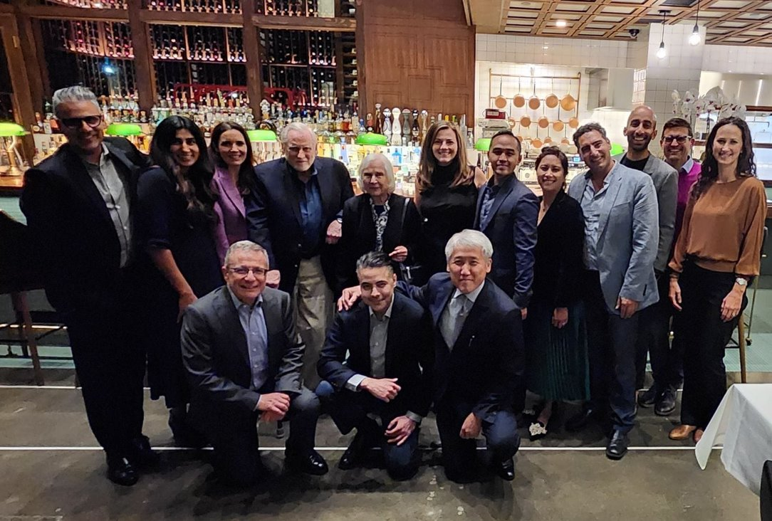
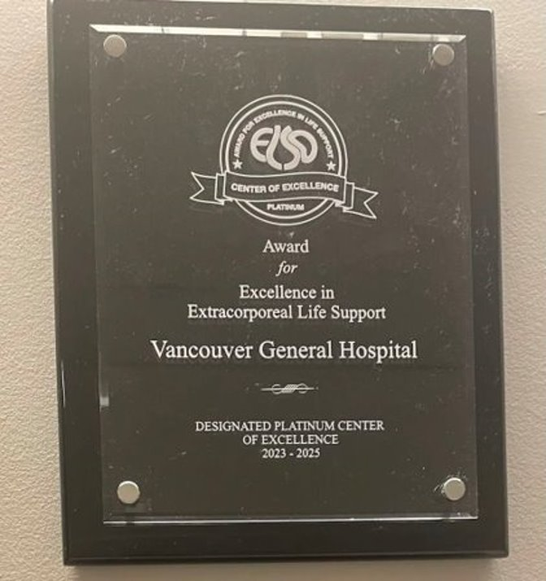
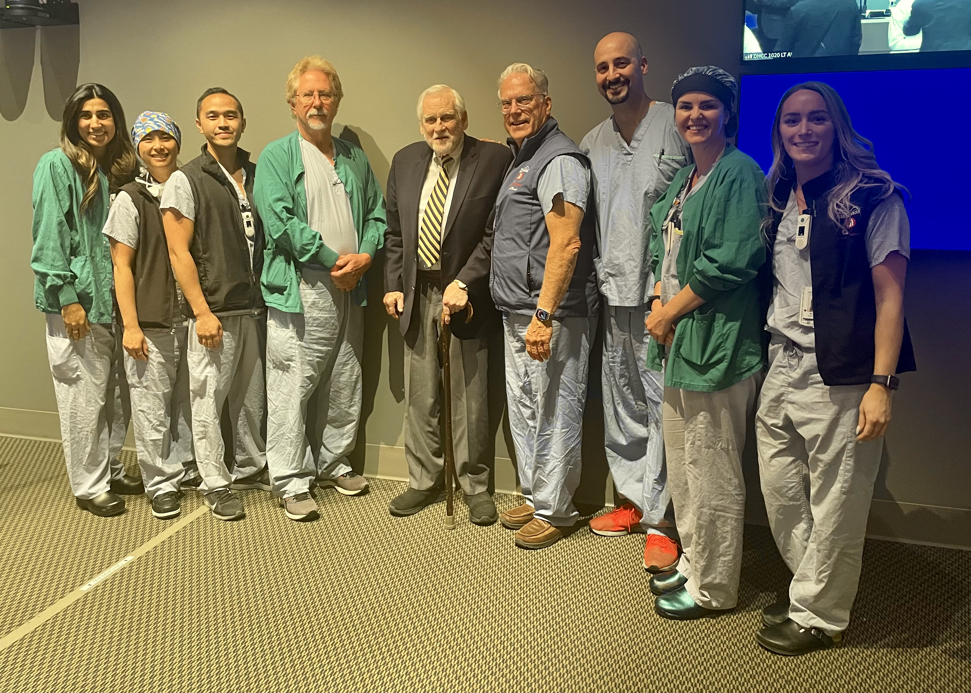
Thank you!
25
Notes:
As the number of adult ECMO cases continues to grow, anesthesiologists will have an increasing role in their care in the operating room and in optimizing patient outcomes
As an ELSO platinum-designated program, we have a very robust team and only gain more experience and insight year over year

Slide 26
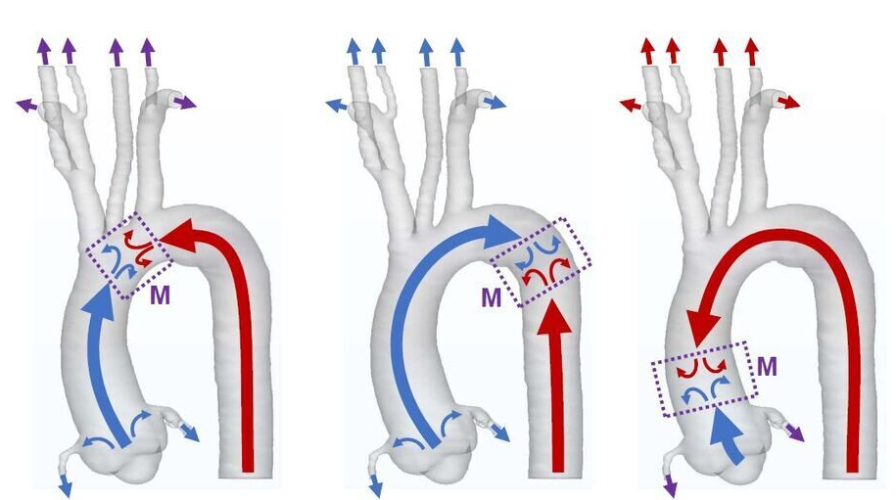
Harlequin
A
B
C

